Slide 1
CARBON FOOTPRINT
MINIPROJECT

Slide 2
NAME: A.C.DEVIPRIYA
REGISTER NUMBER: 111725203018
BRANCH: B.TECH IT

Slide 3
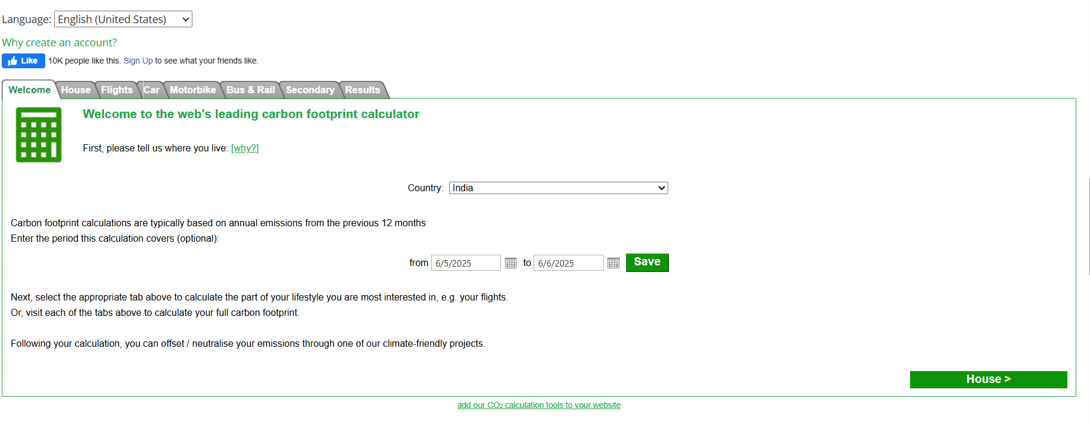

Slide 4
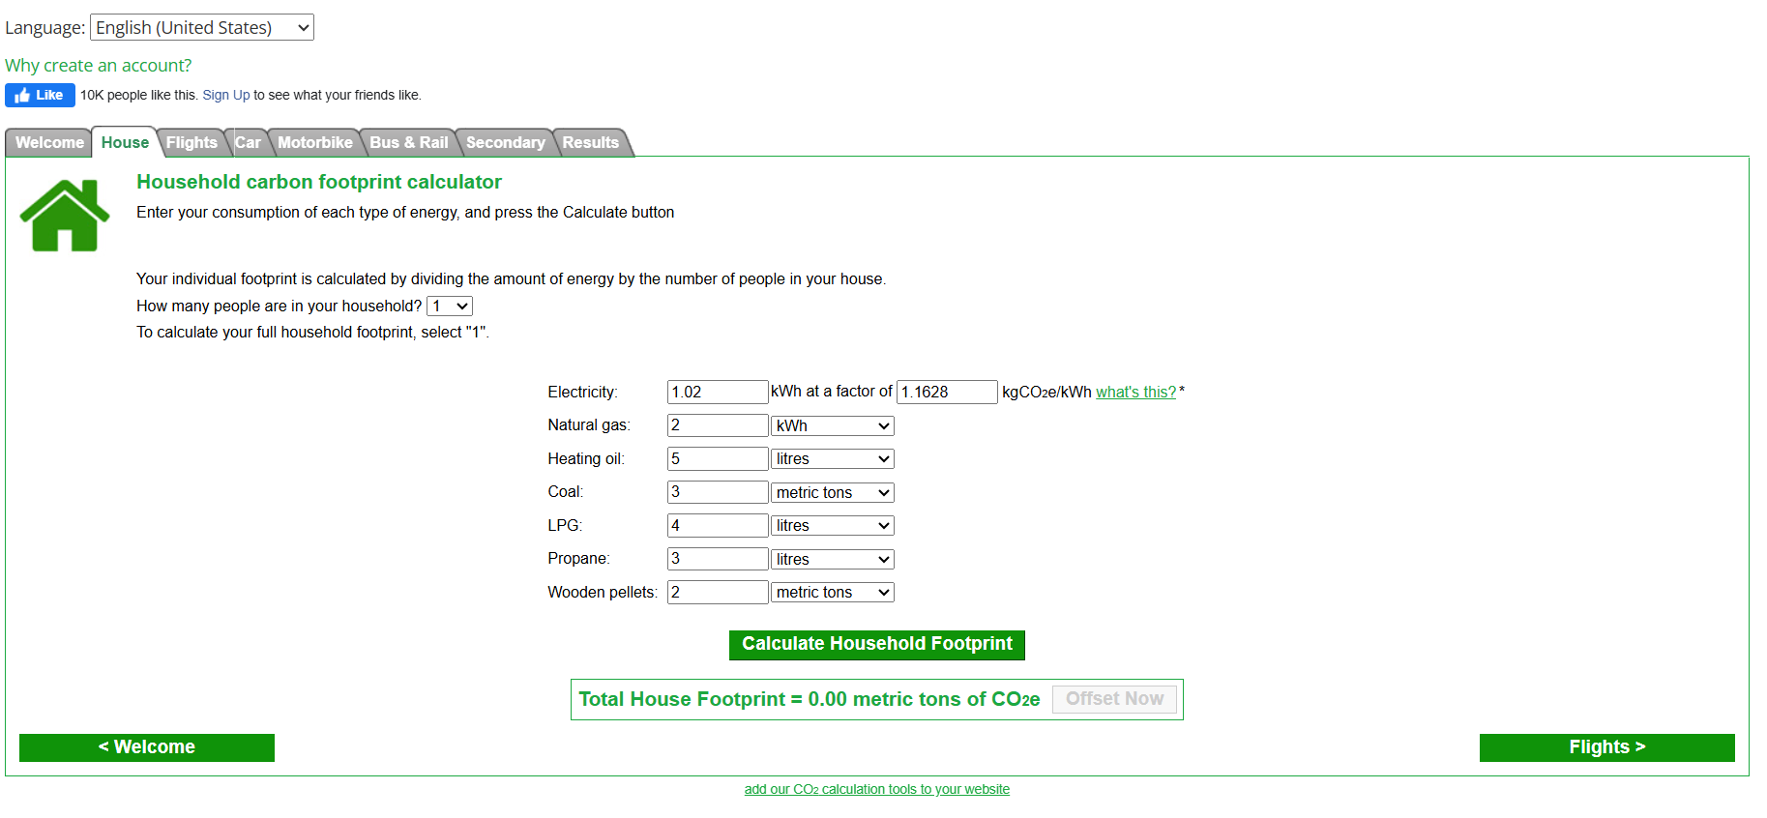

Slide 5
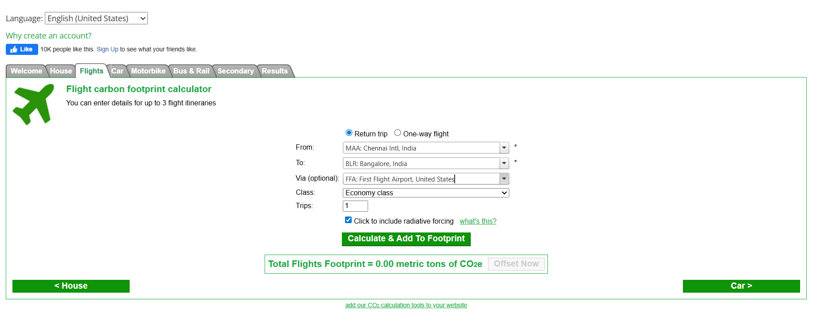

Slide 6
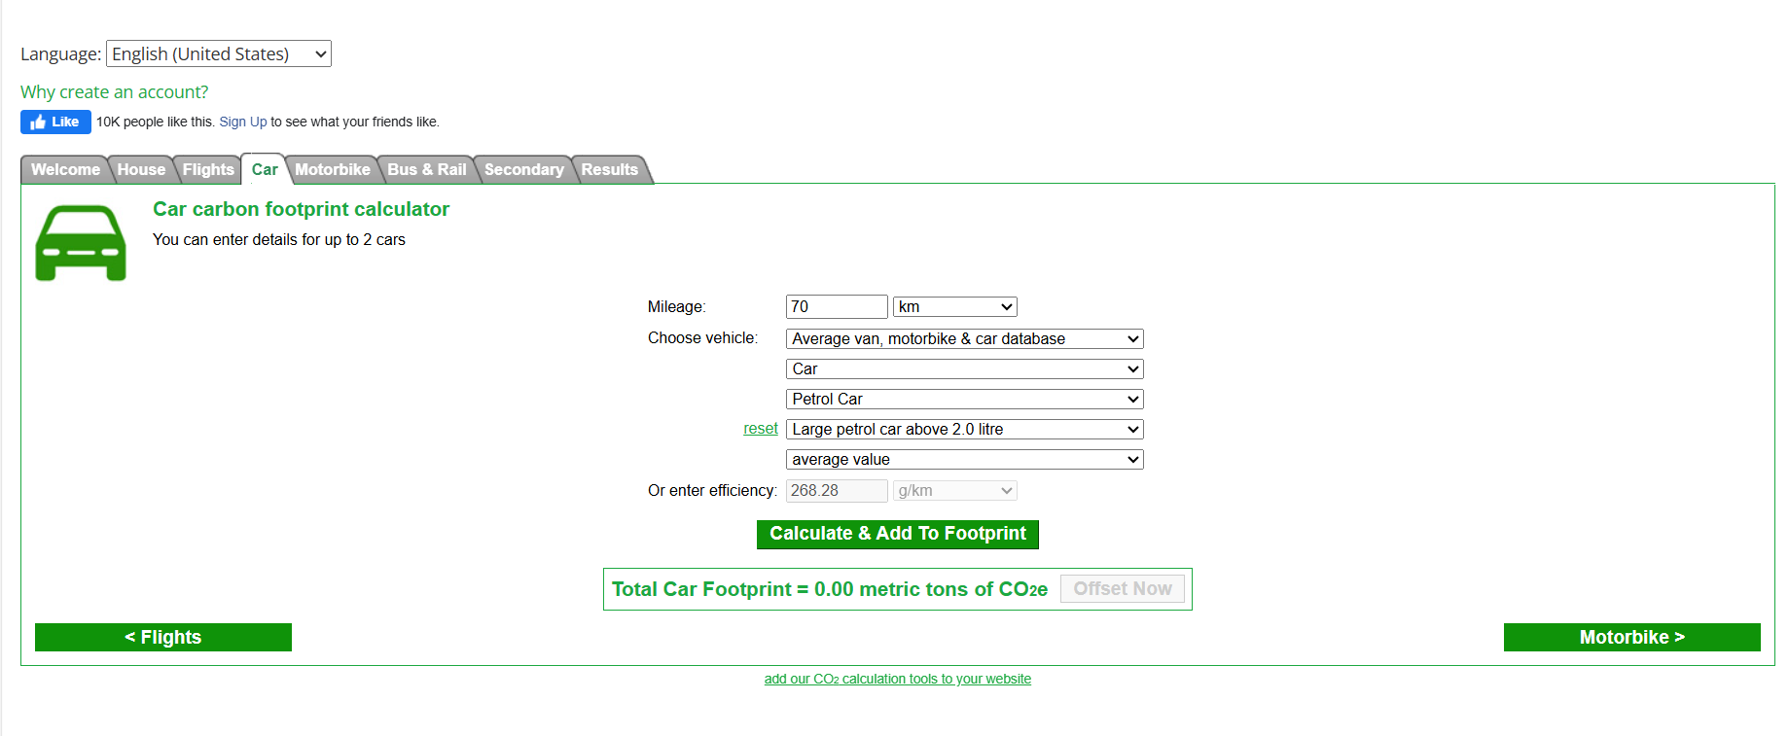

Slide 7


Slide 8
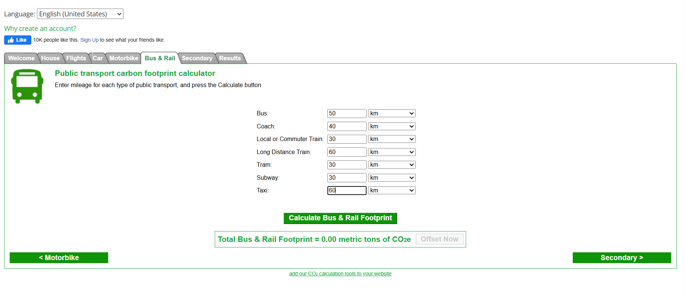

Slide 9
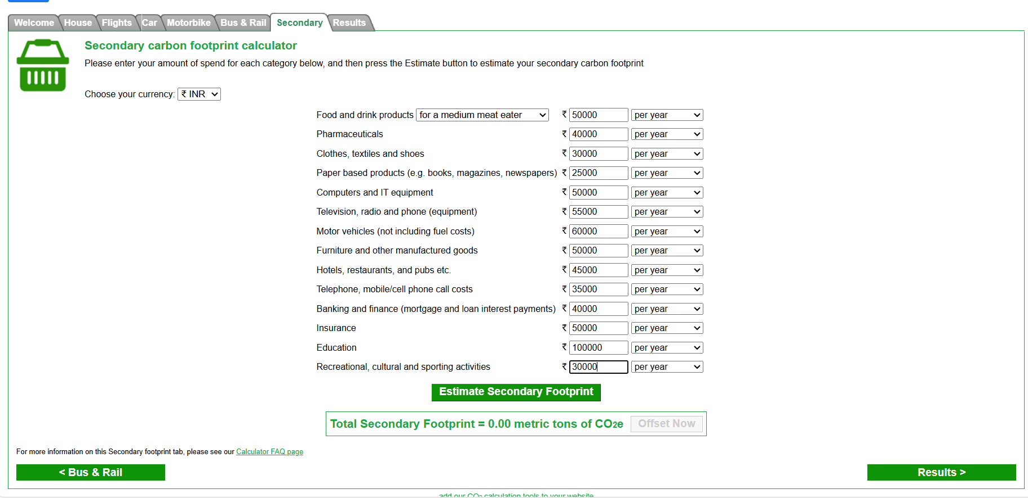

Slide 10
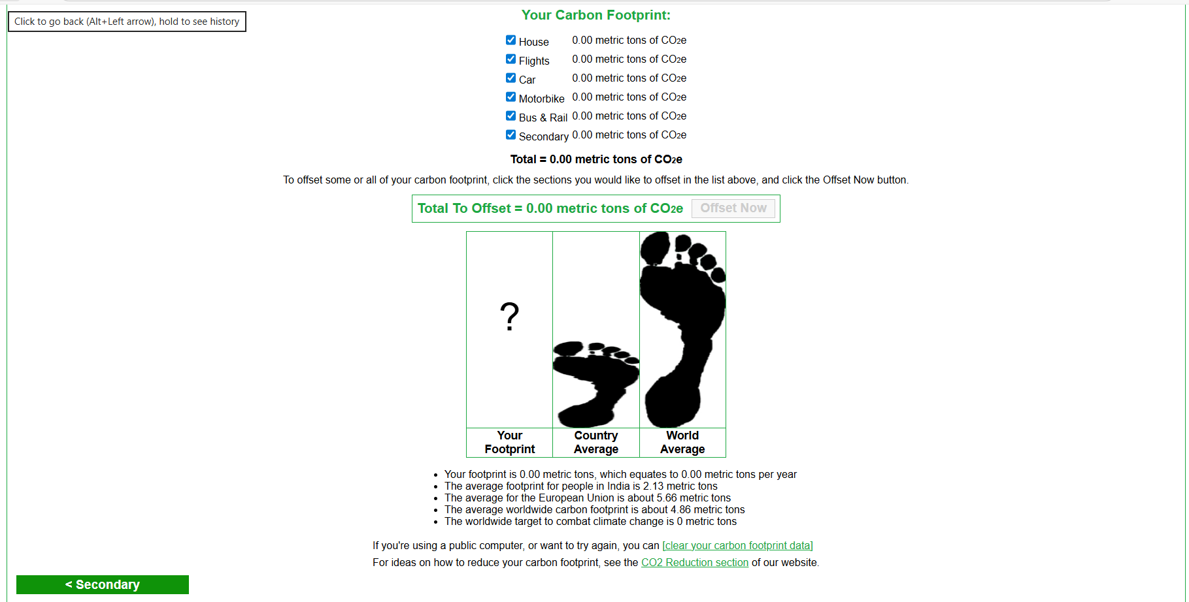

Slide 11
THANK YOU

